Slide 1
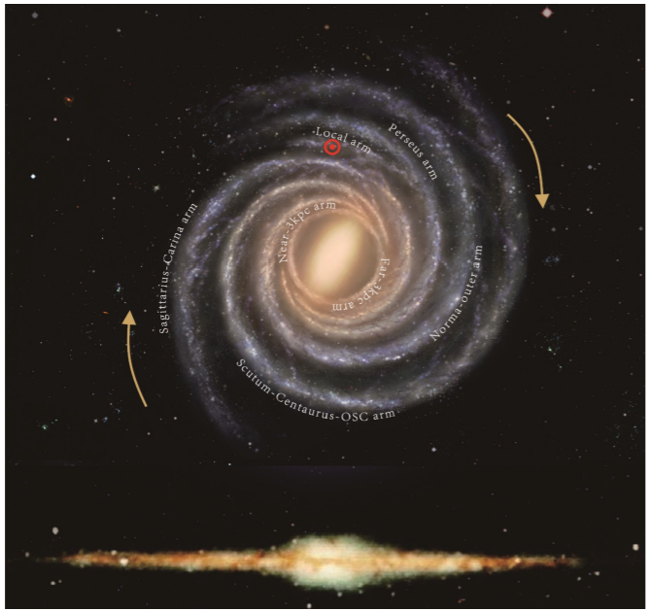

Revisiting the Oort Constants Measurement from Gaia DR2 Observations and Simulations
Shufan Xia
Advised by Karen Masters (Haverford)
& Zhaoyu Li (Shanghai Jiaotong University)

Slide 2
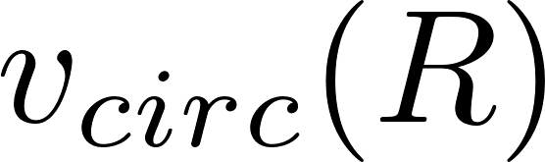
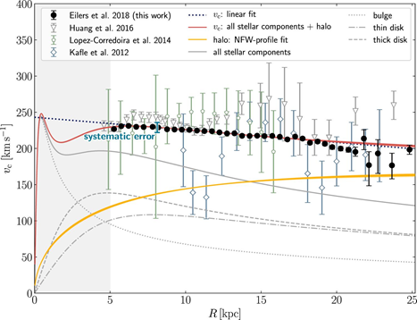
The Milky Way rotation curve tells us a lot about our Galaxy.
Differential rotation
MW potential
Mass distribution: existence of dark matters
We have multiple methods to measure the rotation curve, but it is hard due to observation constraints.
The red line shows the overall rotation curve

Slide 3
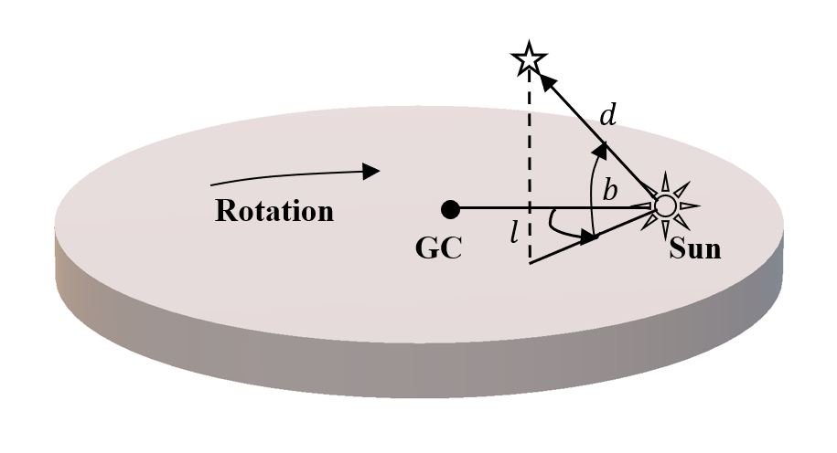
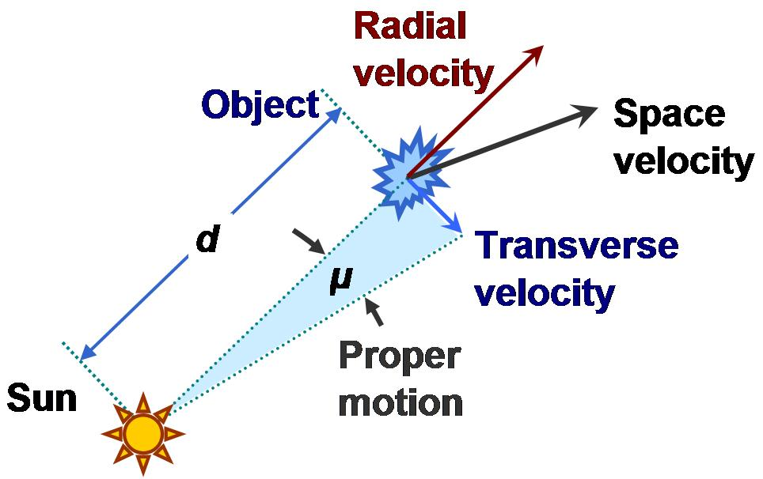
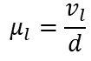
Oort Constants are local tracers of the Galactic kinematics.
Oort Constants describe the local rotation in the solar vicinity:
Galactic coordinate, line-of-sight velocity, proper motion
$$μ_{l}=\frac{v_{l}}{d}$$

Slide 4
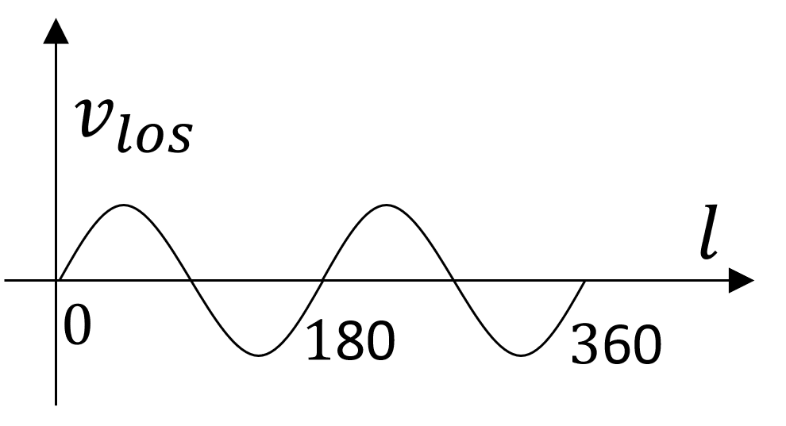
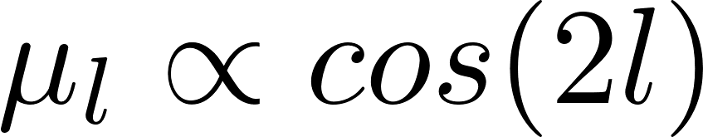
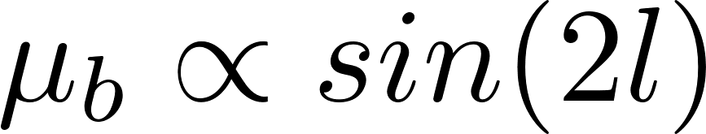
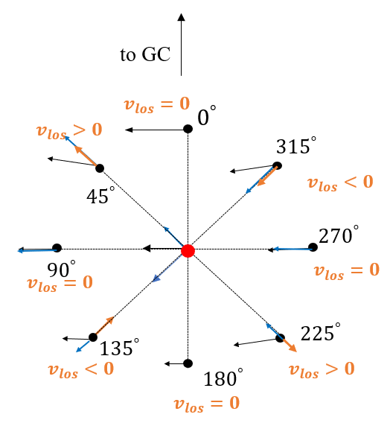
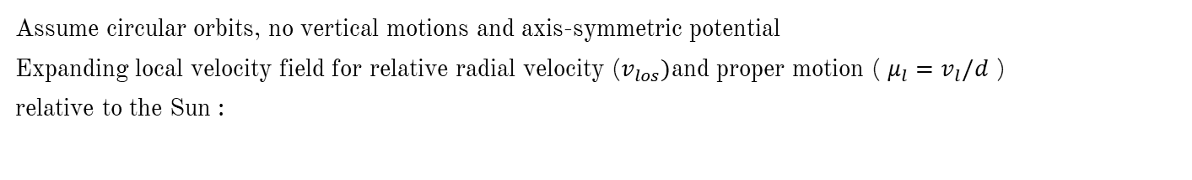
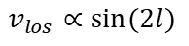
Oort Constants are local tracers of the Galactic kinematics.
Oort Constants describe the local rotation in the solar vicinity:
Assume circular orbits, no vertical motions and axis-symmetric potential
Expanding local velocity field for relative radial velocity ($v_{los})$and proper motion ( $μ_{l}=v_{l}/d$ )
relative to the Sun :
$$v_{los}∝sin⁡(2l)$$
Oort constants describes relative motions about the local standard of rest (LSR)
Correcting the peculiar motion of the Sun about LSR, (u0,v0,w0)
Where: A -- azimuthal shearing, B-- vorticity, C -- radial shearing, K-- divergence

Slide 5
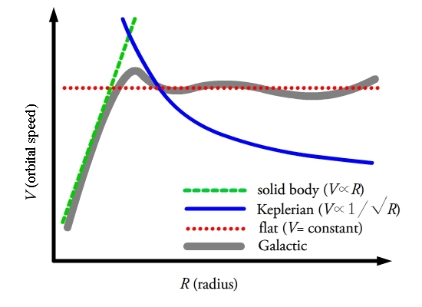
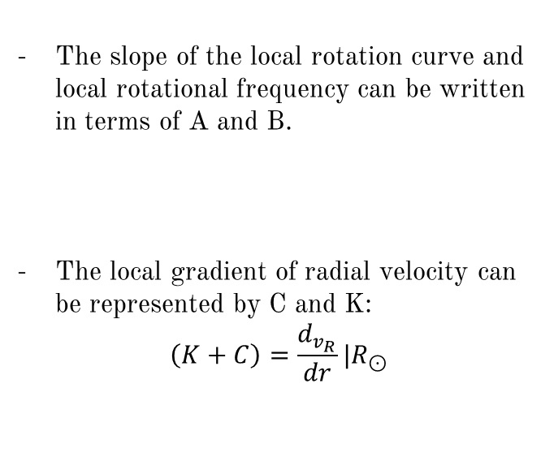
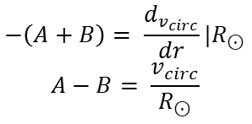
The Oort constants and the MW rotation curve
The slope of the local rotation curve and local rotational frequency can be written in terms of A and B.
The local gradient of radial velocity can be represented by C and K:
$$\left(K+C\right)=\frac{d_{v_{R}}}{dr}|R_{⊙}$$
Slope = -(A+B)
$$−\left(A+B\right)= \frac{d_{v_{circ}}}{dr}|R_{⊙}$$
$$A−B= \frac{v_{circ}}{R_{⊙}}$$
- The Oort constants can be used to test different rotation models.

Slide 6
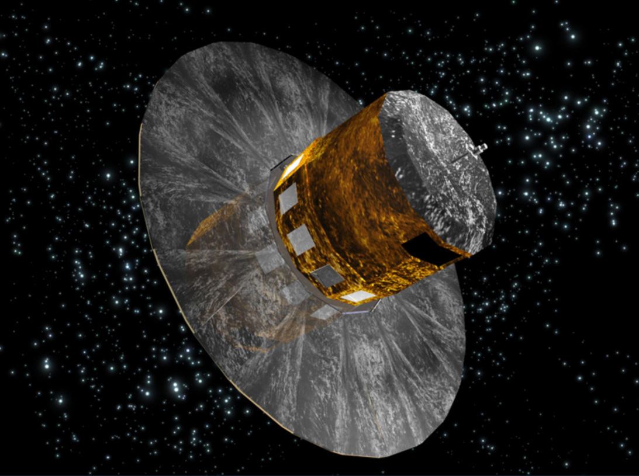
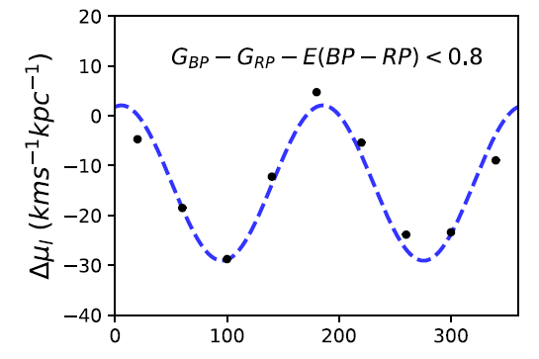
Constraints and influencing factors
Requires a massive proper motion catalogue for stars just distant enough and enough sky coverage.
Non-axisymmetric potential adds ellipticity to circular orbits.
Spiral arms add streaming motions and random motions. (errors of order 5 km/s/kpc in A and B)
The Gaia Space telescope
Gaia DR 2 has proper motion measurements of nearly 1.7 billion stars (Gaia Collaboration et al. 2018).
Previous recent studies of Oort constants: radial velocity unused, using a smaller data set from Gaia DR1 (Bovy, 2017), filtering criteria without much justification. (Li, 2019)
(Li, 2019)

Slide 7
Goal:
using DR2, but with careful consideration of sampling criteria
What is the best subset of stars to estimate Oort constants from observational data?
Establish some guidance for determining the Oort constants from future data release (EDR3/DR3)
We look at this problem with:
Simulation:
1) what we should expect from theories under a relative idealized scenario
2) compare different sample criteria
Gaia DR2 Observation:
1) How the observation data reflect the features predicated by the Oort constants

Slide 8
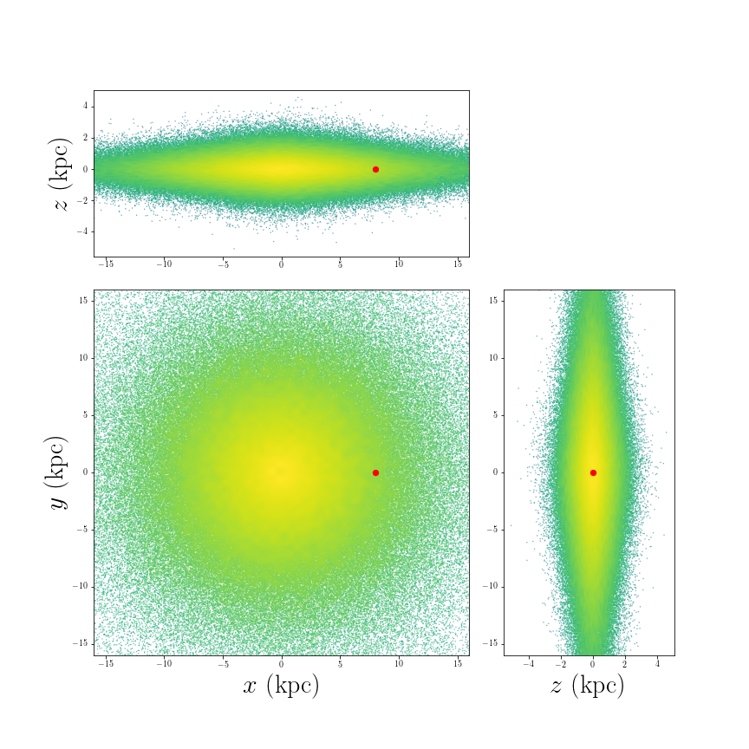
Toy Model Simulation
treating stars as test particles under an axisymmetric MW potential (MWpotential2014, Bovy)
the Sun stays on a circular orbit, (u0,v0,w0)=(0,0,0)
500,000 of test particles from AGAMA's quasi-isothermal distribution function with a scale height of 0.4 kpc, and the radial velocity dispersion is chosen as 10km/s. (Vasiliev 2019).
Dynamically cold disk and reflect general rotation of a thin MW disk
The distribution of stars after orbit integration over 10Gyr to allow them to come to equilibrium
Four symmetric solar positions to have more particles in the solar vicinity.

Slide 9
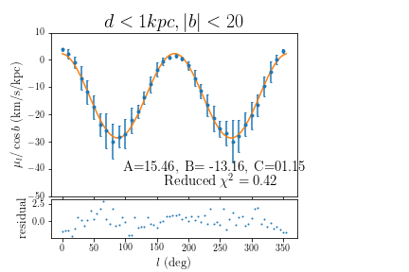
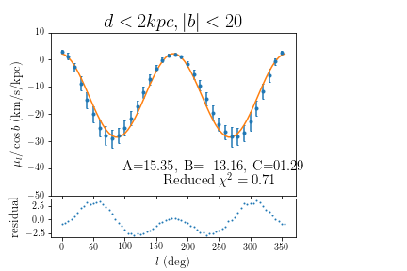
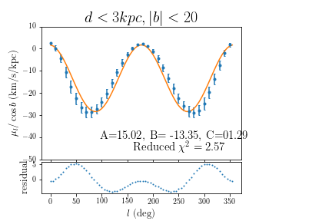
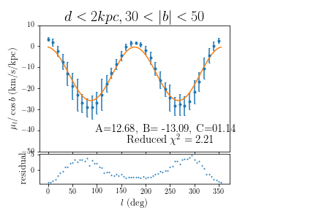
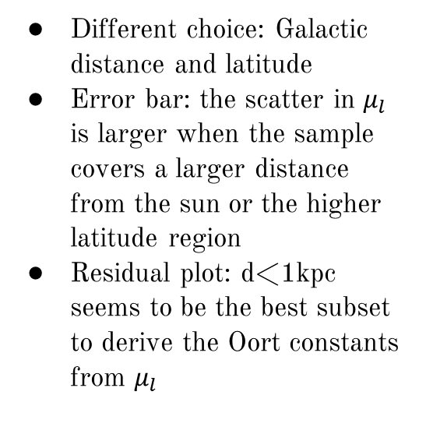
Simulation Results $μ_{l}=\cos{b (A\cos{2l}}−C sin2l+B)$
Different choice: Galactic distance and latitude
Error bar: the scatter in $μ_{l}$ is larger when the sample covers a larger distance from the sun or the higher latitude region
Residual plot: d<1kpc seems to be the best subset to derive the Oort constants from $μ_{l}$

Slide 10
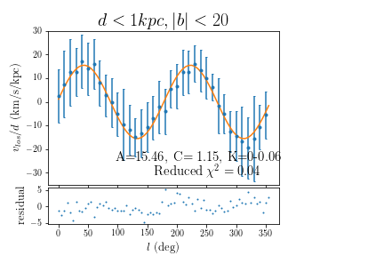
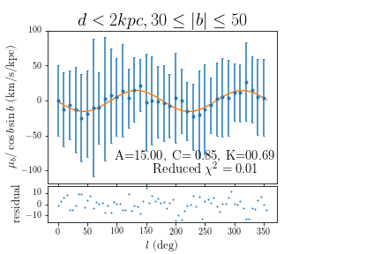
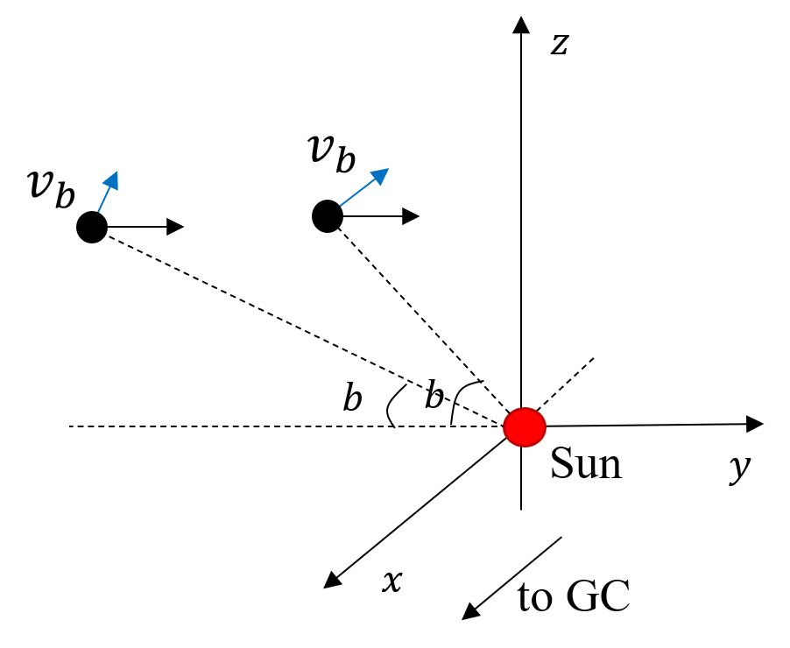
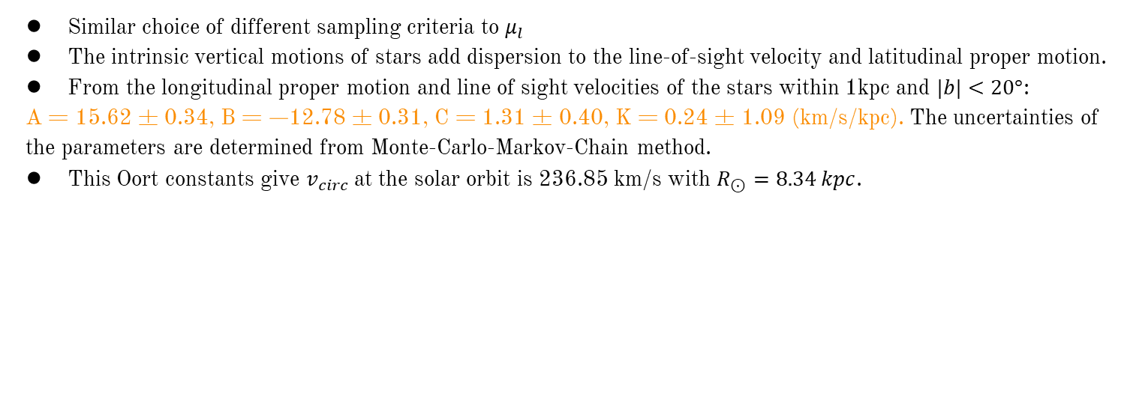
Simulation Results $v_{los}$ and $μ_{b}$
Similar choice of different sampling criteria to $μ_{l}$
The intrinsic vertical motions of stars add dispersion to the line-of-sight velocity and latitudinal proper motion.
From the longitudinal proper motion and line of sight velocities of the stars within 1kpc and $|b|<20°$:
A = 15.62 ± 0.34, B = −12.78 ± 0.31, C = 1.31 ± 0.40, K = 0.24 ± 1.09 (km/s/kpc). The uncertainties of the parameters are determined from Monte-Carlo-Markov-Chain method.
This Oort constants give $v_{circ}$at the solar orbit is 236.85 km/s with $R_{⊙}=8.34 kpc$.

Slide 11
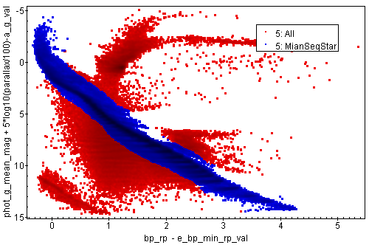
Analyzing Gaia DR2 data
Main sequence star
Color groups on the Hertzsprung Russell (H-R) diagram → stellar age → kinematic features (Bovy, Li)
Selection criteria:
parallax>2mas (d<500pc) from the Sun
parallax/parallax error > 10;
flux over error > 10
Delete duplicated sources
Rewrite, the equations for the Oort constants

Slide 12
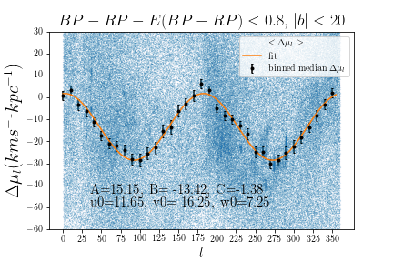
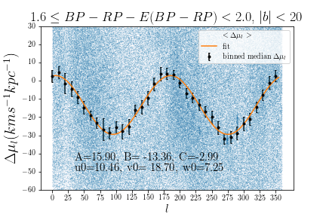
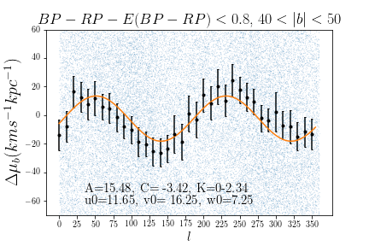
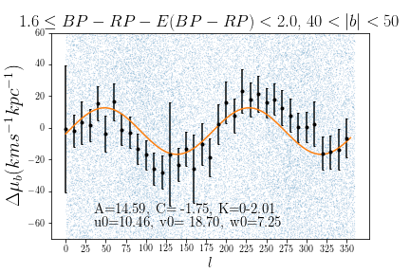
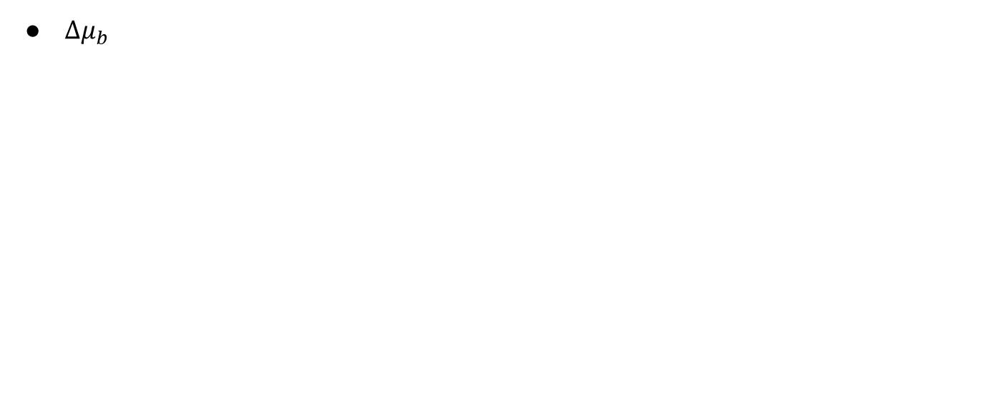
DR2 observations
$Δμ_{b}$
DR2 data confirms the Oort constants model
The error bars and deviations from the model suggests that redder and kinematically older stars have larger velocity dispersion and more non-circular orbital motion.

Slide 13
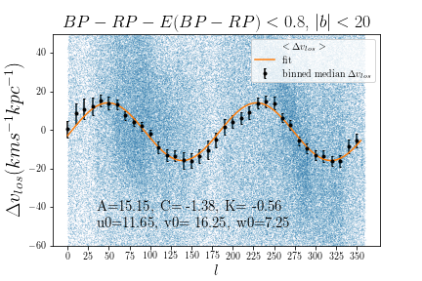
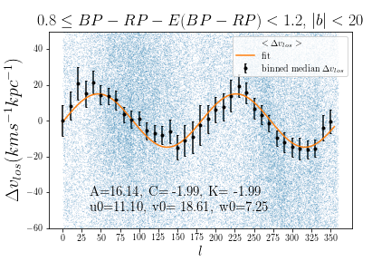
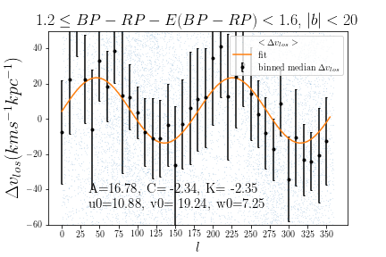
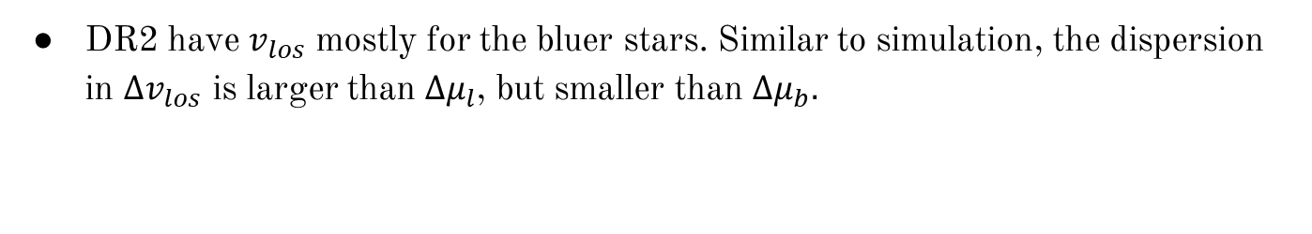
DR2 observations
DR2 have $v_{los}$ mostly for the bluer stars. Similar to simulation, the dispersion in $∆v_{los}$ is larger than ${∆μ}_{l}$, but smaller than ${∆μ}_{b}.$

Slide 14
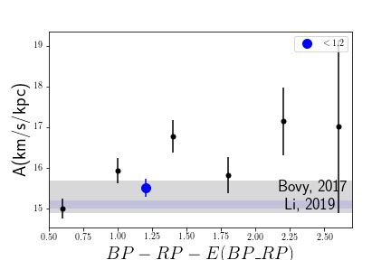
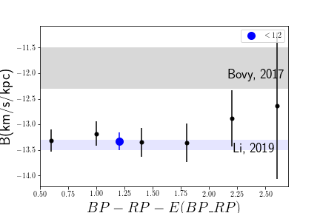
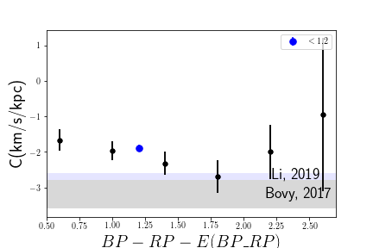
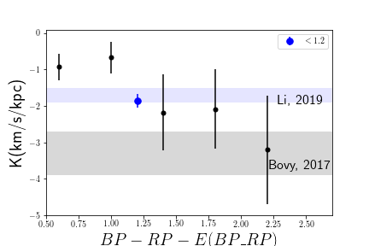
Oort constants estimated for six color groups
Our results agree with Li’s result.
The motions of bluer (younger) stars are generally closer to circular orbital motion, thus being the more reliable tracers for Oort constants.

Slide 15
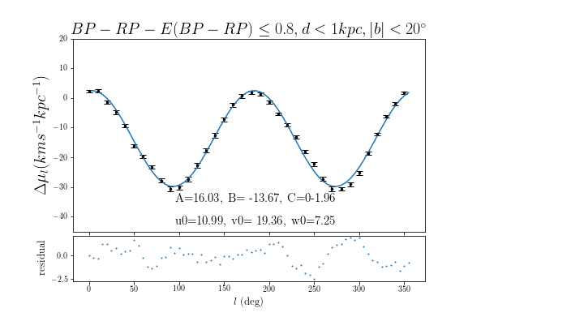
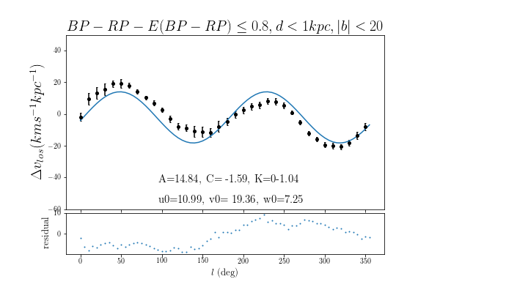
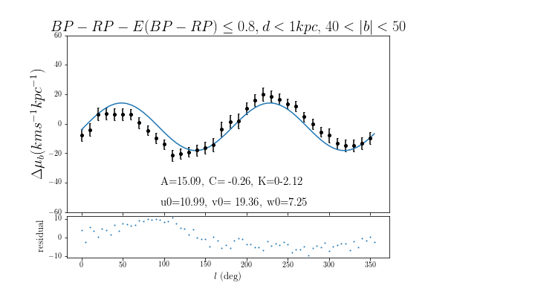
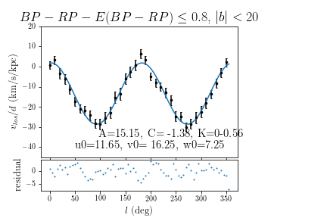
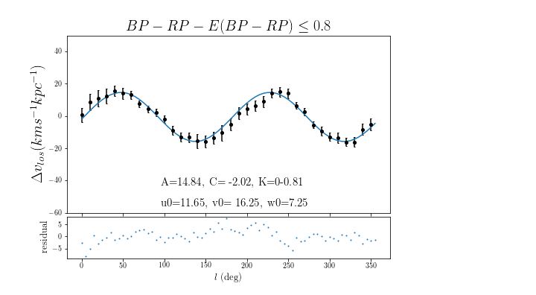
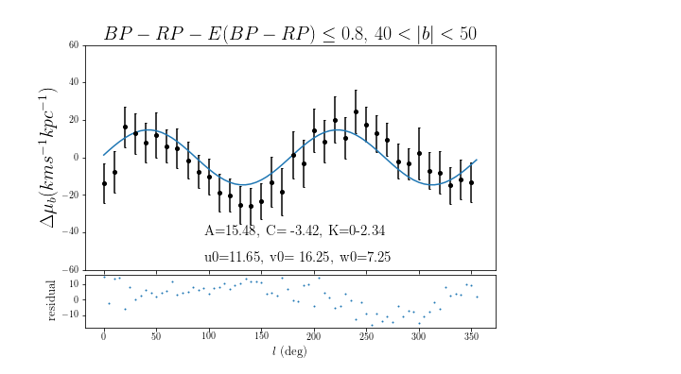
Applying our conclusion from simulation to DR2
Increase the range to within 1kpc from the Sun
distance is a less strict cut-off criterion than the restriction that the Taylor expansion implies
1kpc
500pc

Slide 16
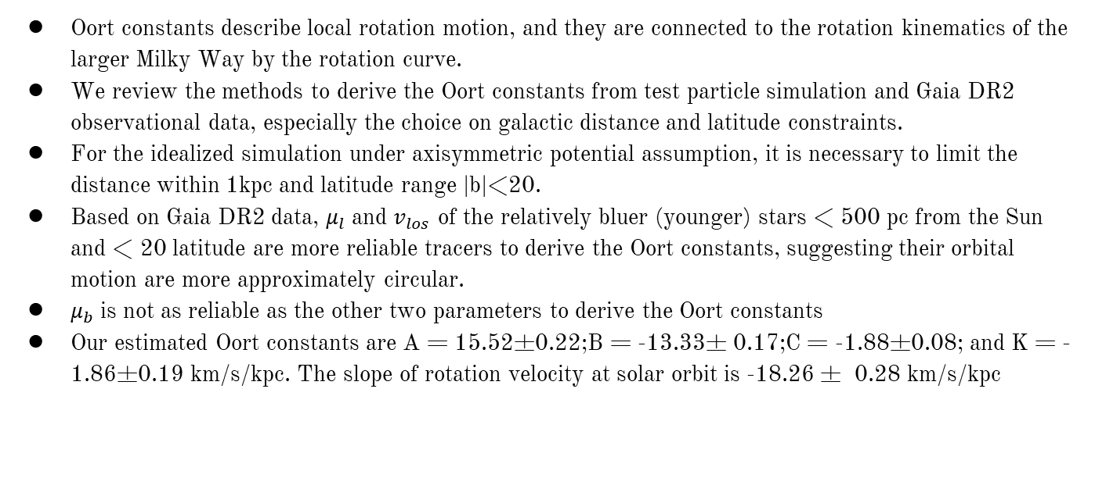
Summary
Oort constants describe local rotation motion, and they are connected to the rotation kinematics of the larger Milky Way by the rotation curve.
We review the methods to derive the Oort constants from test particle simulation and Gaia DR2 observational data, especially the choice on galactic distance and latitude constraints.
For the idealized simulation under axisymmetric potential assumption, it is necessary to limit the distance within 1kpc and latitude range |b|<20.
Based on Gaia DR2 data, $μ_{l}$ and $v_{los}$ of the relatively bluer (younger) stars < 500 pc from the Sun and < 20 latitude are more reliable tracers to derive the Oort constants, suggesting their orbital motion are more approximately circular.
$μ_{b}$ is not as reliable as the other two parameters to derive the Oort constants
Our estimated Oort constants are A = 15.52±0.22;B = -13.33± 0.17;C = -1.88±0.08; and K = -1.86±0.19 km/s/kpc. The slope of rotation velocity at solar orbit is -18.26 ± 0.28 km/s/kpc

Slide 17

Acknowledgement
Prof. Karen Masters
Dr. Zhaoyu Li and Dr. Juntai Shen from Shanghaijiaotong University
This work has made use of data from the European Space Agency (ESA) mission Gaia (https://www.cosmos.esa.int/gaia ), processed by the Gaia Data Processing and Analysis Consortium (DPAC, https://www.cosmos.esa.int/web/gaia/dpac/consortium ). Funding for the DPAC has been provided by national institutions, in particular the institutions participating in the Gaia Multilateral Agreement.

Slide 18
Sources
Artist’s impression of Gaia:European Space Agenecy, https://www.esa.int/ESA_Multimedia/Images/2006/05/Artist_s_impression_of_the_Gaia_satellite
Rotation curve: Eilers, A.-C., Hogg, D. W., Rix, H.-W., & Ness, M. K.2019, ApJ, 871, 120, doi: 10.3847/1538-4357/aaf648
Proper motion: Wikipedia – proper motion
Longitude proper motion: Li, C., Zhao, G., & Yang, C. 2019, ApJ, 872, 205, doi: 10.3847/1538-4357/ab0104
Bovy, J. 2017, MNRAS, 468, L63, doi: 10.1093/mnrasl/slx027

Slide 19
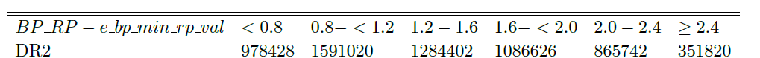
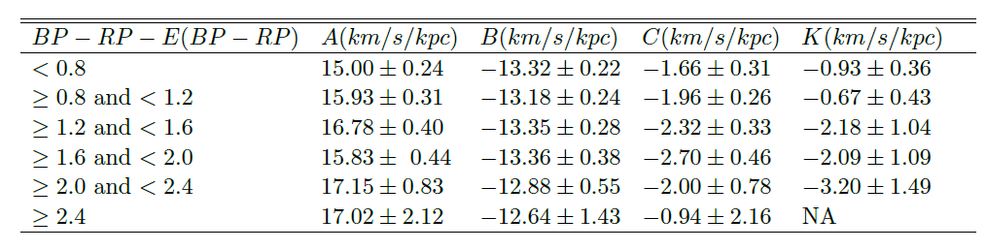


Gaia DR2
Number of main sequence stars fall into each color group for DR2 and EDR3.
(u0,v0) estimated from ${Δμ}_{l}$ for six stellar groups based on color
Oort constants for six stellar groups based on color

Slide 20


Gaia DR2 phase plot

Slide 21


MCMC Corner Plots
Simulation
Gaia DR2

